Slide 1



Mission-critical performance with Microsoft SQL Server 2016
Speaker Name

Slide 2

Summary of Day 1
Real-Time Operational Analytics
In-Memory Optimization (OLTP) enhancements
Stretch Database
Always Encrypted

Slide 3
Summary of Day 2
Query Data Store and Live Query Statistics
PolyBase
Row-Level Security and Dynamic Data Masking
High availability and disaster recovery using Microsoft Azure Virtual Machines

Slide 4


Capabilities and benefits
BI and analytics
Capabilities
Runs analytics queries concurrently with operational workload using same schema
Requires no application changes to run data warehouse queries on In-Memory OLTP workload
Benefits
Minimal impact on OLTP workload
Offers best available performance and scalability
Offloads analytics workload to readable secondary
BI analysts
Presentation layer
Dashboards
Reporting
Dashboards
Reporting
IIS Server
SQL Server
Analysis Services
Application tier
SQL Server
Database
Add analytics-specific indexes

Slide 5
Enabling real-time analytics
BI and analytics
Real-time Operational Analytics targets the scenario that has a single data source, such as an enterprise resource planning (ERP) application, and makes it possible to run both operational and analytics workloads.
This doesn’t replace the need for a separate data warehouse when:
Data from multiple sources must be integrated before running the analytics workload
Extreme analytics performance using pre-aggregated data, such as cubes, is required
OLTP workload
Dashboards
Reporting
Presentation layer
Dashboards
Reporting
Dashboards
Reporting
IIS Server
SQL Server
Analysis Services
Application tier
SQL Server
Database
Add columnstore index

Slide 6
Non-clustered columnstore index
Create updatable non-clustered columnstore index (NCCI) for analytics queries
Drop all other indexes that were created for analytics
Maintain columnstore like any other index
Use Query Optimizer to choose columnstore index where needed
Requires no application changes
B-tree index
B-tree index
Relational table
(clustered index/heap)
Relational table
(clustered index/heap)
Delete bitmap
Delta rowgroups
Non-clustered columnstore index

Slide 7
Using columnstore on in-memory tables
Requires no explicit delta rowgroup
Keeps rows (tail) not in columnstore In-Memory OLTP table
Requires no columnstore index overhead when operating on tail
Uses background task to migrate rows from tail to columnstore in chunks of 1 million rows
Uses Deleted Rows Table (DRT) to track deleted rows
Keeps columnstore data fully resident in memory and persisted together with operational data
You can use Compression Delay to keep data longer in the “tail” to eliminate impact on OLTP workload operating on the “hot” data
Requires no application changes
Hash index
nonclustered index
Deleted rows table
tail
In-Memory OLTP table
Hot

Slide 8

Why In-Memory OLTP?
Customers are demanding ever-higher concurrency and lower latency, at a lower cost
Hardware trends demand architectural changes to the relational database management system (RDBMS) to meet those demands
In-Memory Online Transaction Processing (OLTP), a key new feature of SQL Server 2016, offers:
High performance
Memory-optimized OLTP engine
SQL Server integration
Modern hardware architecture

Slide 9
Why In-Memory OLTP? (continued)
In-Memory OLTP is a memory-optimized database engine integrated into the SQL Server engine, optimized for OLTP, that can significantly improve database application performance
Features of In-Memory OLTP include:
Memory-optimized tables
Natively compiled stored procedures

Slide 10
Why In-Memory OLTP? (continued)
Memory-optimized table
A memory-optimized table has one representation of itself in active memory, in addition to standard representation on hard drive
Business transactions against a table run faster because they directly interact with only representation in active memory
Natively compiled stored procedures
A natively compiled stored procedure is a SQL Server object that can access only memory-optimized data structures (memory-optimized tables, table variables, etc.)
Natively compiled stored procedures require fewer machine instructions during runtime than they would if they were created as traditional interpreted stored procedures

Slide 11
In-Memory OLTP value proposition
Target scenarios: OLTP apps with high throughput and low-latency requirements
Extreme OLTP performance (up to 30x) due to two factors:
High scalability through lock- and latch-free architecture enables linear scaling
Low latency through efficient data access and query processing: memory-optimized data structures and native compilation
Integrated into SQL Server for low total cost of ownership (TCO)
Part of Enterprise Edition
Same databases can have in-memory and on-disk
Integrated developer and DBA experience: same T-SQL, client stack, tooling, backup/restore, AlwaysOn

Slide 12
In-Memory OLTP enhancements
Better T-SQL coverage, including:
Full collations support in native modules
Query surface-area improvements
Nested stored procedures (EXECUTE)
Natively compiled scalar user-defined functions
Query Store support
Other improvements:
Full schema change support: add/alter/drop column/constraint
Increased size allowed for durable tables
ALTER TABLE support
Multiple Active Results Sets (MARS) support
ALTER TABLE Sales.SalesOrderDetail
ALTER INDEX PK_SalesOrderID
REBUILD
WITH (BUCKET_COUNT=100000000)
T-SQL surface area: New
{LEFT|RIGHT} OUTER JOIN
Disjunction (OR, NOT)
UNION [ALL]
SELECT DISTINCT
Subqueries (EXISTS, IN, scalar)

Slide 13
What is Microsoft Stretch Database?
Solution for securely stretching cold tables to Microsoft Azure with remote query processing
Capability
Stretches large operational tables from on-premises to Azure with ability to query
Benefits
Offers cost-effective online cold data
Archives historical data transparently and securely
Keeps entire table online and queryable via on-premises apps
Requires no application changes
Supports Always Encrypted and Row-Level Security
Order History
Order History
SQL
Azure
Stretch to cloud
Order History
Customers
Products
Order History
SQL
Server 2016
App

Slide 14
Capabilities and functions
Migrates your historical data to Microsoft Azure SQL Database
Offers option to pause data migration
Troubleshoots problems on local server
Maximizes available network bandwidth
Ensures no data is lost
Retries logic to handle connection issues
Uses dynamic management view to check migration status
Identifies databases and tables using Stretch Database Advisor, a feature of Microsoft SQL Server 2016 Upgrade Advisor

Slide 15
How Stretch Database works
Creates a secure linked server definition in the on-premises SQL Server
Targets linked server definition as the remote endpoint
Provisions remote resources and begins to migrate eligible data, if migration is enabled
Queries against tables run for both local database and remote endpoint
Local
Database
Internet boundary
Remote Endpoint
Local Data
Remote Data
Linked servers
Eligible Data
On-premises instance
Azure

Slide 16
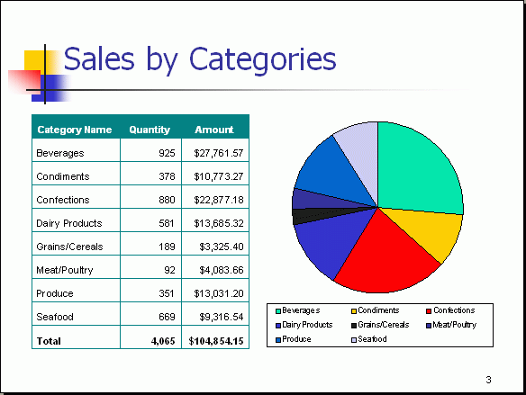
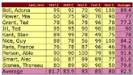
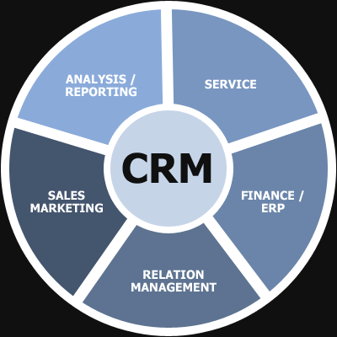
Work without disruption
Business applications continue working without disruption
Database administrator (DBA) scripts and tools work as before; all controls still held in local SQL Server
Developers continue building or enhancing applications with existing tools and methods
Orders
Orders History
Orders History
Trickle migration

Slide 17
What is Always Encrypted?
Prevention of data disclosure
Client-side encryption of sensitive data using keys that are never given to database system
Queries on encrypted data
Support for equality comparison, including join, group by, and distinct operators
Application transparency
Minimal application changes through server and client library enhancements
Allows customers to securely store sensitive data outside of their trust boundary while protecting data from highly privileged (yet unauthorized) users

Slide 18
What is Always Encrypted?
Capability
ADO.NET client library provides transparent client-side encryption, while SQL Server executes T-SQL queries on encrypted data
Benefits
Sensitive data remains encrypted and queryable at all times, on-premises and in the cloud
Unauthorized users never have access to data or keys
No application changes
Data remains encrypted during query
Apps
Encrypted query
TCE-enabled ADO.NET
SQL Server
No app changes
Master key
Columnar key

Slide 19
How does Always Encrypted work?
Encrypted sensitive data and corresponding keys are never seen in plain text in SQL Server
SQL Server or SQL Database
"SELECT Name FROM Customers WHERE SSN = @SSN",
"111-22-3333"
ADO.NET
"SELECT Name FROM Customers WHERE SSN = @SSN",
0x7ff654ae6d
Ciphertext
Result set
Result set
Name
Wayne Jefferson
Name
0x19ca706fbd9a
Name | SSN | Country
0x19ca706fbd9a | 0x7ff654ae6d | USA
Ciphertext

Slide 20
Key provisioning
1. Generate CEKs and master key
Column encryption key
(CEK)
Column
master key
(CMK)
2. Encrypt CEK
Encrypted
CEK
3. Store master key securely
CMK store:
Certificate store
HSM
Azure Key Vault
Security
officer
CMK
4. Upload encrypted CEK to DB
Encrypted CEK
database

Slide 21
Query performance tools
1
Live Query Statistics (LQS)
2
Query Store

Slide 22
How Query Store works
SQL
Collects query texts (plus all relevant properties)
Stores all plan choices and performance metrics
Works across restarts/upgrades/recompiles
Lowers bar for performance troubleshooting
Allows new views
Offers intuitive and easy plan forcing
Compile
Plan store
Compile MSG
Query Store schema
Async write-back
Execute
Runtime stats
Execute MSG
Query Store
Durability latency controlled by DB option
DATA_FLUSH_INTERNAL_SECONDS

Slide 23
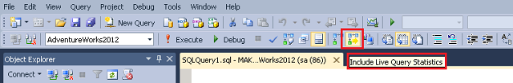
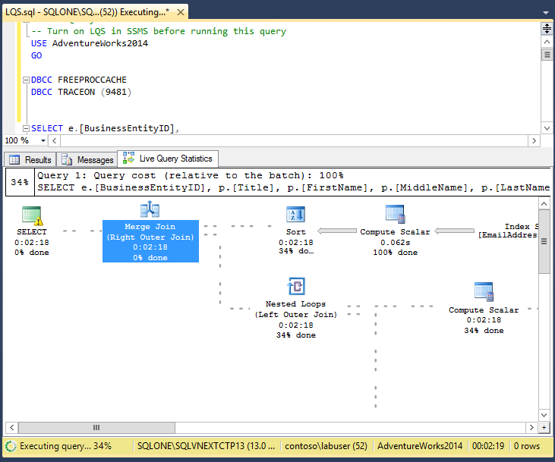
Live Query Statistics Collect actual metrics about query while running
To view live query execution plan, from Tools menu, click Live Query Statistics
Using LQS, you can view CPU/memory usage, execution time, query progress, and so on
Enables rapid identification of potential bottlenecks for troubleshooting query performance issues
Allows drill-down to live operator level statistics:
Number of generated rows
Elapsed time
Operator progress
Live warnings

Slide 24
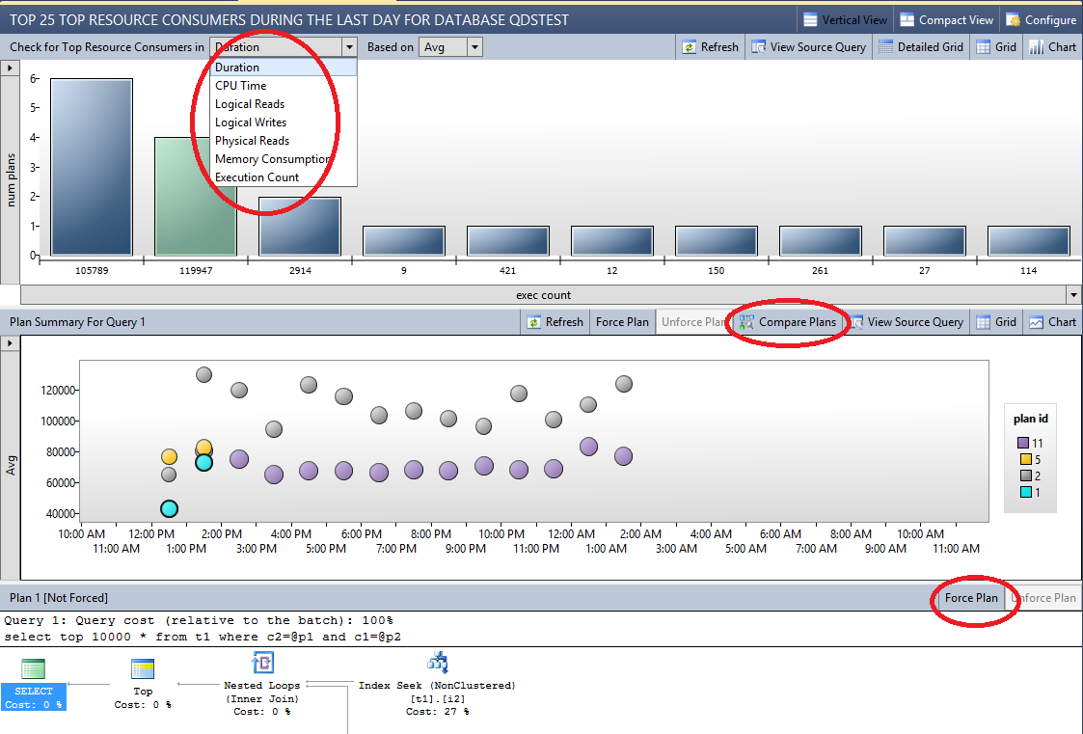
Monitoring query performance
Query Store feature provides DBAs with insight on query plan choice and performance
Regressed Queries pane shows queries and plans in Query Store
Drop-down boxes at top allow you to select queries based on various criteria

Slide 25
Why PolyBase?
Component of PDW region in APS
Transparent Database Encryption (TDE) and Always Encrypted
Highly parallelized, distributed query engine accessing heterogeneous data via SQL
Unique, innovative technology
Seamless integration

Slide 26

How it works
External table
User perspective
External data source
External file format
Systems perspective
PDW engine service
Bridge
Microsoft Azure

Slide 27
PolyBase benefits
Query relational and non-relational data with T-SQL
Capability
T-SQL for querying relational and non-relational data across Microsoft SQL Server and Hadoop
Benefits
New business insights across your Azure Data Lake
Leveraging of existing skill sets and BI tools
Faster time to insights and simplified ETL process
Query relational and non-relational data, on-premises and in Azure
T-SQL query
SQL Server
Hadoop
Apps

Slide 28
PolyBase view in SQL Server 2016
Allow SQL Server 2016 customers to execute T-SQL queries against relational data in SQL Server and “semi-structured” data in HDFS and Azure
Leverage existing T-SQL skills and BI tools to gain insights from different data stores
Expand reach of SQL Server to Hadoop (HDFS)
Query
Results
SQL Server
Hadoop
Azure Blob Storage

Slide 29
Capabilities and functions
Use T-SQL statements to access and query data in Hadoop or Azure Blob Storage
Use T-SQL to store data from Hadoop or Azure Blob Storage
Export data to Hadoop or Azure Blob Storage
Queries
PolyBase
Hadoop
Results
Users
Azure Blob Storage

Slide 30
Need for Row-Level Security (RLS) Collect actual metrics about query while running
Enable fine-grained access control over specific rows in database table
Help prevent unauthorized access when multiple users share same tables, or implement connection filtering in multi-tenant applications
Administer via SQL Server Management Studio or SQL Server Data Tools
Use enforcement logic inside database and schema bound to table
Customer 1
Customer 2
Customer 3
SQL Database

Slide 31
RLS introduction
Shard 1
Shard 2
Tenant 1
Tenant 2
Tenant 3
Tenant 4
BlogID
Name
URL
Tenant
BlogID
Name
URL
Tenant
…
…
…
1
…
…
…
2
Row-Level Security filters based on CONTEXT_INFO
…
…
…
3
…
…
…
2
…
…
…
3
…
…
…
4
Client App
Security Policy
Security Policy
Data dependent routing APIs connect to database
RLS restricts which users can view which data in a table, based on a function. SQL Server 2016 introduces this feature, which is useful in multi-tenant environments where you may want to limit data access based on customer ID.

Slide 32
RLS in three steps
Nurse
Policy manager
Database
Security
Policy
Filter Predicate:
INNER JOIN…
Application
CREATE FUNCTION dbo.fn_securitypredicate(@wing int)
RETURNS TABLE WITH SCHEMABINDING AS
return SELECT 1 as [fn_securitypredicate_result] FROM
StaffDuties d INNER JOIN Employees e
ON (d.EmpId = e.EmpId)
WHERE e.UserSID = SUSER_SID() AND @wing = d.Wing;
CREATE SECURITY POLICY dbo.SecPol
ADD FILTER PREDICATE dbo.fn_securitypredicate(Wing) ON Patients
WITH (STATE = ON)
Patients
SELECT * FROM Patients
SELECT * FROM Patients
SEMIJOIN APPLY dbo.fn_securitypredicate(patients.Wing);
SELECT Patients.* FROM Patients,
StaffDuties d INNER JOIN Employees e ON (d.EmpId = e.EmpId)
WHERE e.UserSID = SUSER_SID() AND Patients.wing = d.Wing;
One Policy manager creates filter predicate and security policy in T-SQL, binding predicate to patient’s table
Two App user (nurse) selects from patient’s table
Three Security policy transparently rewrites query to apply filter predicate

Slide 33
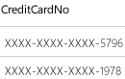
Dynamic Data Masking Prevent abuse of sensitive data by hiding it from users
Dynamic Data Masking
Configuration made easy in new Azure portal
Policy-driven at table and column level for defined set of users
Dynamic Data Masking applied in real time to query results based on policy
Multiple masking functions available (full, partial) for various sensitive data categories (like credit card numbers, SSN)
Table.CreditCardNo
4465-6571-7868-5796
4468-7746-3848-1978
4484-5434-6858-6550
SQL Database
SQL Server 2016
Real-time data masking; partial masking

Slide 34
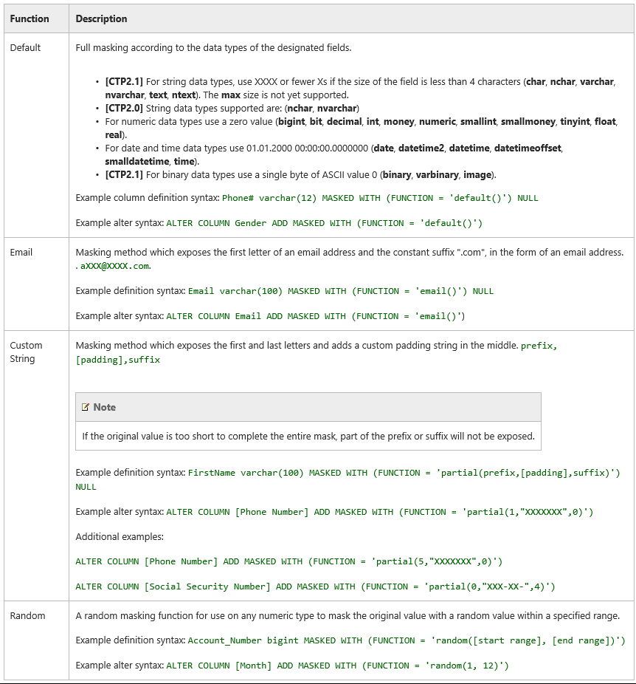
Defining Dynamic Data Masking
A masking rule may be defined on a column in a table in order to protect data in that column.
Four types of masks are available.
A masking rule may be defined on a column in a table, in order to protect data in that column. Four types of masks are available.

Slide 35
SQL Server on-premises with cloud resources
Backup to Azure Storage
Optionally managed
Data files in Azure Storage using file snapshots
On-premises
Microsoft Azure
Azure Storage
AlwaysOn replica in Azure Virtual Machines
Primary
Secondary

Slide 36
Benefits of Azure Backup
Block blobs
Reduced storage costs
Significantly improved restore performance
More granular control over Azure Storage
Azure Storage snapshot backup
Fastest method for creating backups and running restores
Support of SQL Server database files on Azure Blob Storage
Managed backup
Granular control of the backup schedule
Local staging for faster recovery and greater network resiliency
System database support
Simple recovery mode support

Slide 37



Real-Time Operational Analytics overview:
Mission-critical performance with SQL Server 2016
Speaker Name

Slide 38

Learning objectives
Real-Time Operational Analytics overview
Real-Time Operational Analytics with disk-based tables
Real-Time Operational Analytics with In-Memory OLTP
Summary of improvements
Getting started
Examples
Offloading analytics to AlwaysOn readable secondary
Real-Time Operational Analytics use cases
Real-Time Operational Analytics demo

Slide 39
Traditional operational analytics architecture
BI and analytics
Key issues
Complex implementation
Requirement of two servers (both capital and operational expenditures)
Data latency in analytics
More business demand that requires real-time analytics
BI analysts
Presentation layer
Dashboards
Reporting
IIS Server
SQL Server
Analysis Services
Application tier
ETL
SQL Server
Relational DW
SQL Server
Database
Hourly, daily, weekly
Database

Slide 40
Capabilities and benefits
BI and analytics
Capabilities
Runs analytics queries concurrently with operational workload using same schema
Requires no application changes to run data warehouse queries on In-Memory OLTP workload
Benefits
Minimal impact on OLTP workload
Offers best available performance and scalability
Offloads analytics workload to readable secondary
BI analysts
Presentation layer
Dashboards
Reporting
Dashboards
Reporting
IIS Server
SQL Server
Analysis Services
Application tier
SQL Server
Database
Add analytics-specific indexes

Slide 41
Enabling real-time analytics
BI and analytics
Real-time Operational Analytics targets the scenario that has a single data source, such as an enterprise resource planning (ERP) application, and makes it possible to run both operational and analytics workloads.
This doesn’t replace the need for a separate data warehouse when:
Data from multiple sources must be integrated before running the analytics workload
Extreme analytics performance using pre-aggregated data, such as cubes, is required
OLTP workload
Dashboards
Reporting
Presentation layer
Dashboards
Reporting
Dashboards
Reporting
IIS Server
SQL Server
Analysis Services
Application tier
SQL Server
Database
Add columnstore index

Slide 42
Real-Time Operational Analytics goals
Minimal impact on operational workload with concurrent analytics
Performant analytics on operational schema
Achieved using columnstore index

Slide 43
Real-Time Operational Analytics with disk-based tables

Slide 44
Non-clustered columnstore index
Create updatable non-clustered columnstore index (NCCI) for analytics queries
Drop all other indexes that were created for analytics
Maintain columnstore like any other index
Use Query Optimizer to choose columnstore index where needed
Requires no application changes
B-tree index
B-tree index
Relational table
(clustered index/heap)
Relational table
(clustered index/heap)
Delete bitmap
Delta rowgroups
Non-clustered columnstore index

Slide 45
Minimizing columnstore index overhead: Compression Delay
OLTP workload
B-tree index
Control how long the data stays in delta rowgroups
Example: for HOT/WARM (time based)
< 6 hours – HOT (delta store)
Relational table
(clustered index/heap)
HOT
Use analytics queries to access both columnstore and hot data transparently
Delete bitmap
Delta rowgroups
Non-clustered columnstore index

Slide 46
Minimizing columnstore index overhead: Filtered Index
OLTP workload
B-tree index
Create columnstore only on cold data, using filtered predicates to minimize maintenance
Relational table
(clustered index/heap)
HOT
Use analytics queries to access both columnstore and hot data transparently
Delete bitmap
Delta rowgroups
Non-clustered columnstore index – filtered index

Slide 47
Real-Time Operational Analytics with In-Memory OLTP

Slide 48
Using columnstore on in-memory tables
Requires no explicit delta rowgroup
Keeps rows (tail) not in columnstore In-Memory OLTP table
Requires no columnstore index overhead when operating on tail
Uses background task to migrate rows from tail to columnstore in chunks of 1 million rows
Uses Deleted Rows Table (DRT) to track deleted rows
Keeps columnstore data fully resident in memory and persisted together with operational data
You can use Compression Delay to keep data longer in the “tail” to eliminate impact on OLTP workload operating on the “hot” data
Requires no application changes
Hash index
nonclustered index
Deleted rows table
tail
In-Memory OLTP table
Hot

Slide 49
Real-time Analytics: Minimizing Columnstore overhead
Minimizing columnstore index overhead: Readable secondary
Real-time workload
AlwaysOn Availability Group
Analytics workload
Secondary replica
Primary replica
Secondary replica
Secondary replica
Key points
Mission-critical real-time workloads typically configured for high availability using AlwaysOn Availability Group
You can offload analytics to readable secondary replicas

Slide 50
Summary of improvements

Slide 51
Improvements summary
Improvements | SQL Server 2014 | SQL Server 2016
Clustered columnstore index | Master copy of the data (10x compression) Only index supported; simplified analytics No PK/FK constraints Uniqueness can be enforced through Materialized Views Locking granularity for UPDATE/DELETE at rowgroup level DDL: ALTER, REBUILD, REORGANIZE | Master copy of the data (10x compression) Additional b-tree indexes for efficient equality, short-range searches, and PK/FK constraints Locking granularity at row level using NCI index path DDL: ALTER, REBUILD, REORGANIZE
Updatable non-clustered index | Introduced in SQL Server 2012 NCCI is read-only: no delete bitmap or delta store Optimizer will choose between NCCI and NCI(s)/CI or heap-based on the cost-based model Partitioning supported | Updatable Ability to mix OLTP and analytics workload Ability to create filtered NCCI Partitioning supported
Equality and short-range queries | Rowgroup elimination (when possible) Partition-level scan (somewhat expensive) Full index scan (expensive) | Optimizer can choose NCI on column C1; index points directly to rowgroup No full index scan Covering NCI index
String predicate pushdown | Retrieve 10 million rows by converting dictionary encoded value to string Apply string predicate on 10 million rows | Apply filter on dictionary entries Find rows that refer to dictionary entries that qualify (R1) Find rows not eligible for this optimization (R2) Scan returns (R1 + R2) rows Filter node applies string predicate on (R2) Row returned by Filter node = (R1 + R2’)

Slide 52
Getting started

Slide 53
Getting started
Identify tables in operational schema that contain data required for analytics
Examine existing indexes on tables created primarily to speed up the analytics queries
Drop these indexes and replace them by columnstore index
If you are already running operational analytics using b-tree indexes created for analytics, drop those indexes and replace them with single columnstore index

Slide 54
Examples

Slide 55
Example 1: Add columnstore index to existing OLTP table
Creating non-clustered columnstore index on disk-based table
--Example of creating a columnstore index on an existing OLTP table
--Create the table
CREATE TABLE t_account (
accountkey int PRIMARY KEY,
accountdescription nvarchar (50),
accounttype nvarchar(50),
unitsold int
);
--Create the columnstore index with a filtered condition
CREATE NONCLUSTERED COLUMNSTORE INDEX account_NCCI
ON T_account (accountkey, accountdescription, unitsold)
;

Slide 56
Example 2: Add columnstore index to in-memory table
Columnstore index on in-memory tables:
Allow operational analytics by integrating In-Memory OLTP
Allow in-memory columnstore technologies to deliver high performance for OLTP and analytics workloads
Include all columns
-- Create a memory-optimized table with a columnstore index
CREATE TABLE t_account (
accountkey int NOT NULL PRIMARY KEY NONCLUSTERED,
Accountdescription nvarchar (50),
accounttype nvarchar(50),
unitsold int,
INDEX t_account_cci CLUSTERED COLUMNSTORE
)
WITH (MEMORY_OPTIMIZED = ON );
GO

Slide 57
Offloading analytics to AlwaysOn readable secondary

Slide 58
Offloading analytics to AlwaysOn readable secondary
Real-time
workload
Primary
replica
Insert into CreditCardTrans
values (‘123-123-1234’, ‘Surface’, ‘Seattle’, $450.00)
AlwaysOn
Availability
Group
Secondary
replica
Secondary
replica
Secondary
replica
Select count(*) as transactions, max(price)
From creditCardTrans
Where CreditCardID = ‘123-123-123’) and
(date < last-30-days)
Group By city
Analytics
workload
Key points
Mission-critical real-time workloads typically configured for high availability using AlwaysOn availability groups
Capability to offload analytics to readable secondary replica

Slide 59
Use cases

Slide 60
Real-Time Operational Analytics use cases
Healthcare
Financial Services
Transportation and Services
Challenge:
To gain better insight and improve its service-provider value chain
Challenge:
To stay competitive by offering faster insight into financial data
Challenge:
To add a competitive differentiator and develop new revenue streams

Slide 61
Demo

Slide 62

© 2015 Microsoft Corporation. All rights reserved. Microsoft, Windows, Microsoft Azure, and other product names are or may be registered trademarks and/or trademarks in the U.S. and/or other countries. The information herein is for informational purposes only and represents the current view of Microsoft Corporation as of the date of this presentation. Because Microsoft must respond to changing market conditions, it should not be interpreted to be a commitment on the part of Microsoft, and Microsoft cannot guarantee the accuracy of any information provided after the date of this presentation. MICROSOFT MAKES NO WARRANTIES, EXPRESS, IMPLIED OR STATUTORY, AS TO THE INFORMATION IN THIS PRESENTATION

Slide 63
Appendix

Slide 64
Terms
Columnstore: data that is logically organized as a table with rows and columns, and physically stored in a column-wise data format.
Rowstore: data that is logically organized as a table with rows and columns, and then physically stored in a row-wise data format. This has been the traditional way to store relational table data. In SQL Server, rowstore is the underlying data storage format for a heap, a clustered index, and an in-memory table.
Rowgroup: a group of rows that are compressed into columnstore format at the same time. A rowgroup usually contains the maximum number of rows per rowgroup, which is 1,048,576 rows. Each rowgroup contains one column segment for every column in the table.
Column segment: column of data from within the rowgroup. Each column segment is compressed together and stored on physical media.
Clustered columnstore index: the physical storage for the entire table. To reduce fragmentation of the column segments and improve performance, the columnstore index might store some data temporarily into a clustered index, which is called a deltastore, and a b-tree list of IDs for deleted rows. The deltastore operations are handled behind the scenes. To return the correct query results, the clustered columnstore index combines query results from both the columnstore and the deltastore.

Slide 65
Terms (continued)
Deltastore: used with clustered column store indexes only, a deltastore is a clustered index that improves columnstore compression and performance by storing rows until the number of rows reaches a threshold and are then moved into the columnstore. During a large bulk load, most of the rows go directly to the columnstore without passing through the deltastore. Some rows at the end of the bulk load might be too few in number to meet the minimum size of a rowgroup (102,400 rows). When this happens, the final rows go to the deltastore instead of the columnstore. For small bulk loads with less than 102,400 rows, all of the rows go directly to the deltastore. When the deltastore reaches the maximum number of rows, it becomes closed. A tuple-mover process checks for closed rowgroups. When it finds the closed rowgroup, it compresses and stores it into the columnstore.
Non-clustered columnstore index: a nonclustered columnstore index functions the same as a clustered columnstore index. The difference is that a nonclustered index is a secondary index created on a rowstore table, whereas a clustered columnstore index is the primary storage for the entire table. The nonclustered index contains a copy of part or all of the rows and columns in the underlying table. The index is defined as one or more columns of the table, and has an optional condition that filters the rows. A nonclustered columnstore index enables Real-Time Operational Analytics in which the OLTP workload uses the underlying clustered index, while analytics run concurrently on the columnstore index.
Batch Execution: a query processing method in which queries process multiple rows together. Queries on columnstore indexes use batch mode execution, improving query performance typically 2-4x. Batch execution is closely integrated with, and optimized around, the columnstore storage format. Batch-mode execution is sometimes known as vector-based or vectorized execution.

Slide 66


In-Memory Optimization (OLTP) enhancements overview
Mission-critical performance with Microsoft SQL Server 2016
Speaker Name

Slide 67

Learning objectives
Overview of In-Memory OLTP
Enhancements to In-Memory OLTP
Benefits and best practices
In-Memory OLTP hands-on lab

Slide 68
Overview of In-Memory OLTP

Slide 69
Why In-Memory OLTP?
Customers are demanding ever-higher concurrency and lower latency, at a lower cost
Hardware trends demand architectural changes to the relational database management system (RDBMS) to meet those demands
In-Memory Online Transaction Processing (OLTP), a key new feature of SQL Server 2016, offers:
High performance
Memory-optimized OLTP engine
SQL Server integration
Modern hardware architecture

Slide 70
Why In-Memory OLTP? (continued)
In-Memory OLTP is a memory-optimized database engine integrated into the SQL Server engine, optimized for OLTP, that can significantly improve database application performance
Features of In-Memory OLTP include:
Memory-optimized tables
Natively compiled stored procedures

Slide 71
Why In-Memory OLTP? (continued)
Memory-optimized table
A memory-optimized table has one representation of itself in active memory, in addition to standard representation on hard drive
Business transactions against a table run faster because they directly interact with only representation in active memory
Natively compiled stored procedures
A natively compiled stored procedure is a SQL Server object that can access only memory-optimized data structures (memory-optimized tables, table variables, etc.)
Natively compiled stored procedures require fewer machine instructions during runtime than they would if they were created as traditional interpreted stored procedures

Slide 72
In-Memory OLTP value proposition
Target scenarios: OLTP apps with high throughput and low-latency requirements
Extreme OLTP performance (up to 30x) due to two factors:
High scalability through lock- and latch-free architecture enables linear scaling
Low latency through efficient data access and query processing: memory-optimized data structures and native compilation
Integrated into SQL Server for low total cost of ownership (TCO)
Part of Enterprise Edition
Same databases can have in-memory and on-disk
Integrated developer and DBA experience: same T-SQL, client stack, tooling, backup/restore, AlwaysOn

Slide 73
In-Memory OLTP enhancements
Better T-SQL coverage, including:
Full collations support in native modules
Query surface-area improvements
Nested stored procedures (EXECUTE)
Natively compiled scalar user-defined functions
Query Store support
Other improvements:
Full schema change support: add/alter/drop column/constraint
Increased size allowed for durable tables
ALTER TABLE support
Multiple Active Results Sets (MARS) support
ALTER TABLE Sales.SalesOrderDetail
ALTER INDEX PK_SalesOrderID
REBUILD
WITH (BUCKET_COUNT=100000000)
T-SQL surface area: New
{LEFT|RIGHT} OUTER JOIN
Disjunction (OR, NOT)
UNION [ALL]
SELECT DISTINCT
Subqueries (EXISTS, IN, scalar)

Slide 74
Enhancements to In-Memory OLTP

Slide 75
Altering memory-optimized tables
| ADD
{
<column_definition>
| <table_constraint>
| <table_index>
} [ ,...n ]
| DROP
{
[ CONSTRAINT ]
{
constraint_name
} [ ,...n ]
| COLUMN
{
column_name
} [ ,...n ]
| INDEX
{
index_name
} [ ,...n ]
} [ ,...n ]
| ALTER INDEX index_name
{
REBUILD (WITH <rebuild_index_option>)
}
}
<rebuild_index_option> ::=
BUCKET_COUNT = bucket_count
)
ALTER TABLE syntax is used for making changes to table schema, as well as for adding, deleting, and rebuilding indexes
Indexes are considered part of table definition
Ability to change the BUCKET_COUNT with an ALTER INDEX statement

Slide 76
Altering natively compiled stored procedures
CREATE PROCEDURE [dbo].[usp_1]
WITH NATIVE_COMPILATION, SCHEMABINDING, EXECUTE AS OWNER
AS BEGIN ATOMIC WITH
(
TRANSACTION ISOLATION LEVEL = SNAPSHOT, LANGUAGE = N'us_english'
)
SELECT c1, c2 from dbo.T1
END
GO
ALTER PROCEDURE [dbo].[usp_1]
WITH NATIVE_COMPILATION, SCHEMABINDING, EXECUTE AS OWNER
AS BEGIN ATOMIC WITH
(
TRANSACTION ISOLATION LEVEL = SNAPSHOT, LANGUAGE = N'us_english'
)
SELECT c1 from dbo.T1
END
GO
You can now perform ALTER operations on natively compiled stored procedures using ALTER PROCEDURE statement
Use sp_recompile to recompile stored procedures on next execution

Slide 77
Greater Transact-SQL coverage
CREATE PROCEDURE (Transact-SQL)
DROP PROCEDURE (Transact-SQL)
ALTER PROCEDURE (Transact-SQL)
SELECT (Transact-SQL) and INSERT SELECT statements
SCHEMABINDING and BEGIN ATOMIC (required for natively compiled stored procedures)
NATIVE_COMPILATION
Parameters and variables can be declared as NOT NULL
Table-valued parameters.
GRANT and DENY permissions on tables and procedures.
Nesting natively compiled stored procedures
RIGHT OUTER JOIN, LEFT OUTER JOIN, INNER JOIN, and CROSS JOIN in SELECT statements
NOT, OR, and IN operators in SELECT, UPDATE and DELETE statement
UNION ALL and UNION
SELECT DISTINCT
GROUP BY clause with no aggregate functions in the SELECT clause (<select> list).
COLUMNSTORE
COLLATE

Slide 78
Improved scaling
Other enhancements include:
Multiple threads to persist memory-optimized tables
Multi-threaded recovery
MERGE operation
Dynamic management view improvements to sys.dm_db_xtp_checkpoint_stats and sys.dm_db_xtp_checkpoint_files
The In-Memory OLTP engine has been enhanced to scale linearly on servers up to four sockets

Slide 79
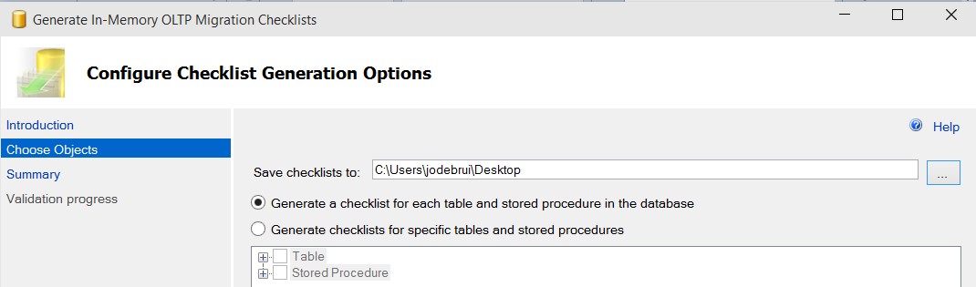
Improvements in Management Studio
Lightweight performance analysis
Transaction Performance Analysis report pinpoints hot spots in app
Migration checklists
Migration checklists show unsupported features used in current disk-based tables and interpreted T-SQL stored procedures
Generates checklists for all or some tables and procedures
Uses GUI or PowerShell

Slide 80
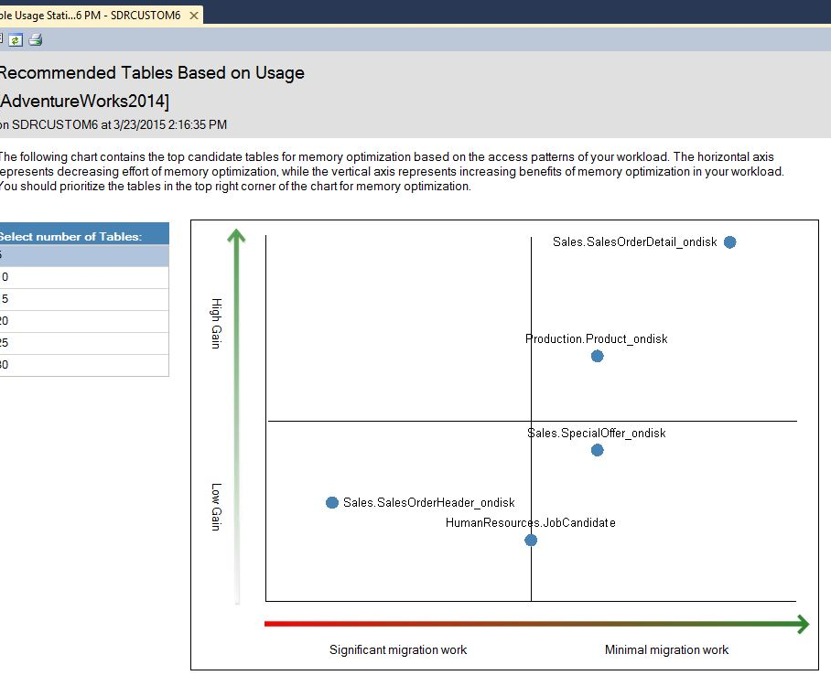
New transaction performance analysis overview report
New report replaces need to use Management Data Warehouse to analyze which tables and stored procedures are candidates for In-Memory OLTP

Slide 81
Using multiple active result sets
Setup MARS connection for memory optimized tables using MultipleActiveResultsSets=True in your connection string
Data Source=MSSQL; Initial Catalog=AdventureWorks; Integrated Security=SSPI; MultipleActiveResultSets=True

Slide 82
Support for Transparent Data Encryption
Transparent Database Encryption (TDE) architecture
Windows Operating System
level-data protection
In SQL Server 2016, storage for memory-optimized tables will be encrypted as part of enabling TDE on database
Simply follow same steps as you would for a disk-based database
DPAPI encrypts Service Master Key
SQL Server
instance level
Created at time of SQL Server setup
Service Master Key
Service Master Key encrypts Database Master Key for master database
Master database level
Statement: CREATE MASTER KEY…
Database Encryption Key
Database Master Key of master database creates certificate in master database
Statement: CREATE CERTIFICATE…
Certificate encrypts Database Encryption Key in user database
User database level
Statement: CREATE DATABASE ENCRYPTION KEY…
Database Encryption Key
Entire user database is secured by Database Encryption Key of user database with transparent database encryption
Statement: ALTER DATABASE… SET ENCRYPTION0.

Slide 83
Benefits and best practices

Slide 84
Benefits
This table summarizes workload patterns that may benefit most with In-Memory OLTP
Implementation scenario | Implementation scenario | Benefits of In-Memory OLTP
High-data insertion rate from multiple concurrent connections | Primarily append-only store Unable to keep up with insert workload | Eliminate contention Reduce logging
Read performance and scale with periodic batch inserts and updates | High-performance read operation, especially when each server request has multiple read operations to perform Unable to meet scale-up requirements | Eliminate contention when new data arrives Lower latency data retrieval Minimize code execution time
Intensive business logic processing in database server | Insert, update, and delete workload Intensive computation inside stored procedures Read and write contention | Eliminate contention Minimize code execution time for reduced latency and improved throughput
Low latency | Low-latency business transaction required, which typical database solutions can’t achieve | Eliminate contention Minimize code execution time Low-latency code execution Efficient data retrieval
Session state management | Frequent insert, update, and point lookups High-scale load from numerous stateless web servers | Eliminate contention Efficient data retrieval Option IO reduction or removal, when using non-durables tables

Slide 85
Other benefits and best practices
When to use In-Memory OLTP to improve performance
Short-running transactions
Programming patterns including concurrency scenarios, point lookups, and workloads in which there are many inserts and updates, and business logic in stored procedures
How In-Memory OLTP improves performance and scalability
Optimized algorithms to access memory-resident data
Optimistic concurrency control that eliminates logical locks
Natively compiled stored procedures, with better performance than interpreted stored procedures for accessing memory-optimized tables

Slide 86
Hands-on lab (HOL)

Slide 87
© 2015 Microsoft Corporation. All rights reserved. Microsoft, Windows, Microsoft Azure, and other product names are or may be registered trademarks and/or trademarks in the U.S. and/or other countries. The information herein is for informational purposes only and represents the current view of Microsoft Corporation as of the date of this presentation. Because Microsoft must respond to changing market conditions, it should not be interpreted to be a commitment on the part of Microsoft, and Microsoft cannot guarantee the accuracy of any information provided after the date of this presentation. MICROSOFT MAKES NO WARRANTIES, EXPRESS, IMPLIED OR STATUTORY, AS TO THE INFORMATION IN THIS PRESENTATION

Slide 88

Stretch Database overview:
Mission-critical performance with SQL Server 2016
Speaker Name

Slide 89

Learning objectives
Microsoft Stretch Database overview
Capabilities and functions
How Stretch Database works
Security, backup, and restoration features
Benefits of Stretch Database
Stretch Database hands-on lab

Slide 90
Microsoft Stretch Database overview

Slide 91
Ever growing data, ever shrinking IT
What do we have?
Massive tables
Cold data―infrequently accessed, always online
Maintenance challenges
Business service level agreements (SLAs) at risk
What do we need?
Expanded server and storage
Consolidated datacenter
Indefinite data storage
Flexible and safe options for moving and deleting data

Slide 92
What is Microsoft Stretch Database?
Solution for securely stretching cold tables to Microsoft Azure with remote query processing
Capability
Stretches large operational tables from on-premises to Azure with ability to query
Benefits
Offers cost-effective online cold data
Archives historical data transparently and securely
Keeps entire table online and queryable via on-premises apps
Requires no application changes
Supports Always Encrypted and Row-Level Security
Order History
Order History
SQL
Azure
Stretch to cloud
Order History
Customers
Products
Order History
SQL
Server 2016
App

Slide 93
Purpose
With data continuously growing at a high rate, users generally want to retain all of it—including closed business (archived) data—for purposes such as:
Regulatory compliance
Auditing
Planning
Nature of business
Determining what data can be safely deleted

Slide 94
Users
Accountants and auditors
Fraud investigators (insurance, banks)
Inventory and supply chain managers (retailers)
Business and planning analysts

Slide 95
Capabilities and functions

Slide 96
Capabilities and functions
Migrates your historical data to Microsoft Azure SQL Database
Offers option to pause data migration
Troubleshoots problems on local server
Maximizes available network bandwidth
Ensures no data is lost
Retries logic to handle connection issues
Uses dynamic management view to check migration status
Identifies databases and tables using Stretch Database Advisor, a feature of Microsoft SQL Server 2016 Upgrade Advisor

Slide 97
What can be used in it?
Transactional databases with large amounts of historical data, typically stored in a small number of tables
Entire tables in Microsoft SQL Server 2016 Community Technology Preview 3 (CTP 3.0)
Notes:
.

Slide 98
How Stretch Database works

Slide 99
How Stretch Database works
Creates a secure linked server definition in the on-premises SQL Server
Targets linked server definition as the remote endpoint
Provisions remote resources and begins to migrate eligible data, if migration is enabled
Queries against tables run for both local database and remote endpoint
Local
Database
Internet boundary
Remote Endpoint
Local Data
Remote Data
Linked servers
Eligible Data
On-premises instance
Azure

Slide 100
Typical workflow
High-level steps
Configure local server for remote data archive
Create credential with administrator permission
Alter specific database for remote data archive
Alter table for remote data archive
-- Enable local server
EXEC sp_configure 'remote data archive' , '1';
RECONFIGURE;
-- Provide administrator credential to connect to
-- Azure SQL Database
CREATE CREDENTIAL <server_address> WITH
IDENTITY = <administrator_user_name>,
SECRET = <administrator_password>
-- Alter database for remote data archive
ALTER DATABASE <database name>
SET REMOTE_DATA_ARCHIVE = ON (SERVER = server name);
GO
-- Alter table for remote data archive
ALTER TABLE <table name>
ENABLE REMOTE_DATA_ARCHIVE
WITH ( MIGRATION_STATE = ON );
GO;

Slide 101
Work without disruption
Business applications continue working without disruption
Database administrator (DBA) scripts and tools work as before; all controls still held in local SQL Server
Developers continue building or enhancing applications with existing tools and methods
Orders
Orders History
Orders History
Trickle migration

Slide 102
Security, backup, and restoration features

Slide 103
Security
Data in motion always via secure channels (TLS1.1 / 1.2)
Always Encrypted supported if enabled by user
Encryption key remains on-premises
Row-level security already works with this feature
SQL Server and SQL Azure audit already works with this feature
Orders
Orders History
Orders History
Trickle migration

Slide 104
Backup and restoration
DBAs backup/restore local SQL Server hot data only
Stretch Database ensures remote data transactionally consistent with local SQL Server
Upon completion of local restoration, SQL Server reconciles with remote using metadata―not data copy―operation
SQL Server offers remote restoration with time not dependent on size of data
Backup/Restore
Auto reconcile
Orders
Orders History
Orders History
Trickle migration

Slide 105
Capabilities and functions
Enabling and disabling Stretch Database for SQL Server Instance
Configure databases for Stretch Database, migrate data, and query data on the remote endpoint
Enabling and Disabling Stretch Database for a database or table
CONTROL DATABASE permission
To configure a table for Stretch Database, you must have ALTER privilege
Data Access
Does not change the permissions model of an existing database

Slide 106
Security and Permissions
User Application
Local
Database
Internet boundary
Remote Endpoint
Local Data
Remote Data
Linked servers
Eligible Data
On-premises instance
Azure

Slide 107
Hands-on lab (HOL)

Slide 108
© 2015 Microsoft Corporation. All rights reserved. Microsoft, Windows, Microsoft Azure, and other product names are or may be registered trademarks and/or trademarks in the U.S. and/or other countries. The information herein is for informational purposes only and represents the current view of Microsoft Corporation as of the date of this presentation. Because Microsoft must respond to changing market conditions, it should not be interpreted to be a commitment on the part of Microsoft, and Microsoft cannot guarantee the accuracy of any information provided after the date of this presentation. MICROSOFT MAKES NO WARRANTIES, EXPRESS, IMPLIED OR STATUTORY, AS TO THE INFORMATION IN THIS PRESENTATION

Slide 109

Always Encrypted overview
Mission-critical performance with Microsoft SQL Server 2016
Speaker Name

Slide 110

Learning objectives
Overview of Always Encrypted
Key provisioning and feature details
Limitations and roadblocks
Best practices
Always Encrypted hands-on lab

Slide 111
Always Encrypted overview

Slide 112
What is Always Encrypted?
Prevention of data disclosure
Client-side encryption of sensitive data using keys that are never given to database system
Queries on encrypted data
Support for equality comparison, including join, group by, and distinct operators
Application transparency
Minimal application changes through server and client library enhancements
Allows customers to securely store sensitive data outside of their trust boundary while protecting data from highly privileged (yet unauthorized) users

Slide 113
What is Always Encrypted?
Capability
ADO.NET client library provides transparent client-side encryption, while SQL Server executes T-SQL queries on encrypted data
Benefits
Sensitive data remains encrypted and queryable at all times, on-premises and in the cloud
Unauthorized users never have access to data or keys
No application changes
Data remains encrypted during query
Apps
Encrypted query
TCE-enabled ADO.NET
SQL Server
No app changes
Master key
Columnar key

Slide 114
Users
Randomized encryption
Encrypt('123-45-6789') = 0x17cfd50a
Repeat: Encrypt('123-45-6789') = 0x9b1fcf32
Allows for transparent retrieval of encrypted data but no operations
More secure
Deterministic encryption
Encrypt('123-45-6789') = 0x85a55d3f
Repeat: Encrypt('123-45-6789') = 0x85a55d3f
Allows for transparent retrieval of encrypted data and quality comparison (for example, in WHERE clauses and joins, distinct, group by)
Two types of encryption are available:
Randomized encryption uses method that encrypts data in less predictable manner
Deterministic encryption uses method that always generates same encrypted value for any given plain text value

Slide 115
Users
Medical and healthcare professionals
Financial institutions
Social services
Hospitals
Private practices
Banks
Credit unions

Slide 116
Capabilities and functions
Migration of sensitive data in application
Automatic encryption and decryption of sensitive data
Bulk loading of encrypted data
SQL Server only handles encrypted data—not plain text values
Automatically rewrites queries to preserve semantics to application
Driver transparently decrypts data

Slide 117
Data migration scenarios
Recommended settings are appropriate for several migration scenarios
Scenario | Source schema | Target schema
Encrypt data on migration | Plaintext | Encrypted
Decrypt data on migration | Encrypted | Plaintext
Re-encrypt data on migration | Encrypted | Encrypted
Copy data without decrypting | Encrypted | Encrypted
Source settings |  | Target settings
Column encryption setting | Allow encrypted values modifications | Column encryption setting | Allow encrypted values modifications
Any (Disabled is recommended) | N/A (OFF is recommended) | Enabled | OFF
Enabled | N/A (OFF is recommended) | N/A (Disabled is recommended) | N/A (OFF is recommended)
Enabled | N/A (OFF is recommended) | Enabled | OFF
Disabled | N/A (OFF is recommended) | Disabled | ON

Slide 118
Where can Always Encrypted be used?
Client and data on-premises
Client on-premises with data in Azure
Client and data in Azure
Customer has client application and SQL Server, both running on-premises at business location
Customer has on-premises client application at business location
Customer has client application hosted in Azure (for example, in worker or web role), which operates on sensitive data also stored in Azure

Slide 119
How does Always Encrypted work?
Encrypted sensitive data and corresponding keys are never seen in plain text in SQL Server
SQL Server or SQL Database
"SELECT Name FROM Customers WHERE SSN = @SSN",
"111-22-3333"
ADO.NET
"SELECT Name FROM Customers WHERE SSN = @SSN",
0x7ff654ae6d
Ciphertext
Result set
Result set
Name
Wayne Jefferson
Name
0x19ca706fbd9a
Name | SSN | Country
0x19ca706fbd9a | 0x7ff654ae6d | USA
Ciphertext

Slide 120
Key provisioning and feature details

Slide 121
Key provisioning
1. Generate CEKs and master key
Column encryption key
(CEK)
Column
master key
(CMK)
2. Encrypt CEK
Encrypted
CEK
3. Store master key securely
CMK store:
Certificate store
HSM
Azure Key Vault
Security
officer
CMK
4. Upload encrypted CEK to DB
Encrypted CEK
database

Slide 122
Example
Client - trusted
CMK Store
SQL Server - untrusted
using (SqlCommand cmd = new SqlCommand(
"SELECT Name FROM Customers WHERE SSN = @SSN“
, conn))
{
cmd.Parameters.Add(new SqlParameter(
"@SSN", SqlDbType.VarChar, 11).Value =
"111-22-3333");
SqlDataReader reader =
cmd.ExecuteReader();
Enhanced ADO.NET
exec sp_describe_parameter_encryption
@params = N'@SSN VARCHAR(11)'
, @tsql = N'SELECT * FROM Customers WHERE SSN = @SSN'
Param | Encryption type/ algorithm | Encrypted CEK value | CMK store provider name | CMK path
@SSN | DET/ AES 256 |  | CERTIFICATE_STORE | Current User/ My/f2260…
Plaintext CEK
Cache
Encryption metadata
EXEC sp_execute_sql
N'SELECT * FROM Customers WHERE SSN = @SSN'
, @params = N'@SSN VARCHAR(11)', @SSN=0x7ff654ae6d
Result set (plain text)
Param | Encryption type/ algorithm | Encrypted CEK value | CMK store provider name | CMK path
@Name | Non-DET/ AES 256 |  | CERTIFICATE_STORE | Current User/ My/f2260…
Name
Jim Gray
Encryption metadata
Name
0x19ca706fbd9
Result set (ciphertext)

Slide 123
Feature details
Ability to perform equality comparison on columns encrypted using deterministic encryption
Queries on columns encrypted using randomized encryption cannot perform operations on those columns
Column encryption key can have up to two different encrypted values
Deterministic encryption requires column to have one of binary2 collations
Indexing columns encrypted using randomized encryption is not supported
Query parameters that map to encrypted columns must be passed as driver-level parameters

Slide 124
Limitations and roadblocks

Slide 125
What doesn’t work in Always Encrypted?
Not supported when columns use any of these datatypes
Clauses that cannot be used for encrypted columns
FOR XML
FOR JSON PATH
Features that do not work on encrypted columns
Transactional or merge replication
Distributed queries (linked servers)
xml rowversion image ntext text sql_variant | hierarchyid geography geometry alias user-defined types

Slide 126
Potential roadblocks
Data corruption
Tool limitations

Slide 127
Best practices

Slide 128
Best practices
If a database containing sensitive data is hosted in Azure, complete isolation of data from cloud administrators is only provided when the database client tier is running on-premises
If the client tier is running in the cloud, moving the encryption/decryption routine to the client tier still leaves data and keys exposed to cloud administrators (of the platform hosting the client tier)
For long-running workloads, use designated user accounts with this option
For short-running bulk copy applications or tools that need to move encrypted data without decrypting it, set option to ON immediately before running and back to OFF immediately after completion
Do not use this option for developing new applications
Instead, use client driver (such as ADO 4.6.1) that offers API for suppressing cryptographic metadata checks for single session

Slide 129
Hands-on lab (HOL)

Slide 130
© 2015 Microsoft Corporation. All rights reserved. Microsoft, Windows, Microsoft Azure, and other product names are or may be registered trademarks and/or trademarks in the U.S. and/or other countries. The information herein is for informational purposes only and represents the current view of Microsoft Corporation as of the date of this presentation. Because Microsoft must respond to changing market conditions, it should not be interpreted to be a commitment on the part of Microsoft, and Microsoft cannot guarantee the accuracy of any information provided after the date of this presentation. MICROSOFT MAKES NO WARRANTIES, EXPRESS, IMPLIED OR STATUTORY, AS TO THE INFORMATION IN THIS PRESENTATION.

Slide 131
Appendix

Slide 132
Terms
Deterministic encryption uses a method that always generates the same encrypted value for any given plain text value. Using deterministic encryption allows grouping, filtering by equality, and joining tables based on encrypted values—but can also allow unauthorized users to guess information about encrypted values by examining patterns in the encrypted column. This weakness is increased with a small set of possible encrypted values, such as true/false or north/south/east/west region. Deterministic encryption must use a column collation with a binary2 sort order for character columns.
Randomized encryption uses a method that encrypts data in a less predictable manner. Randomized encryption is more secure, but prevents equality searches, grouping, indexing, and joining on encrypted columns.
Column master keys are protecting keys used to encrypt column encryption keys. Column master keys must be stored in a trusted key store. Information about column master keys, including their location, is stored in the database in system catalog views.
Column encryption keys are used to encrypt sensitive data stored in database columns. All values in a column can be encrypted using a single column encryption key. Encrypted values of column encryption keys are stored in the database in system catalog views. You should store column encryption keys in a secure/trusted location for backup.

